Slide 1

Forecasting Outcomes of 2018 Women’s March Madness
W207 Final Project
Julia Buffinton, Charlene Chen, Arvindh Ganesan, Prashant Kumar Sahay

Slide 2
Content
Goals and Impact
Data Understanding and Preparation
Feature Engineering and Selection
Modeling
Evaluation and Deployment

Slide 3
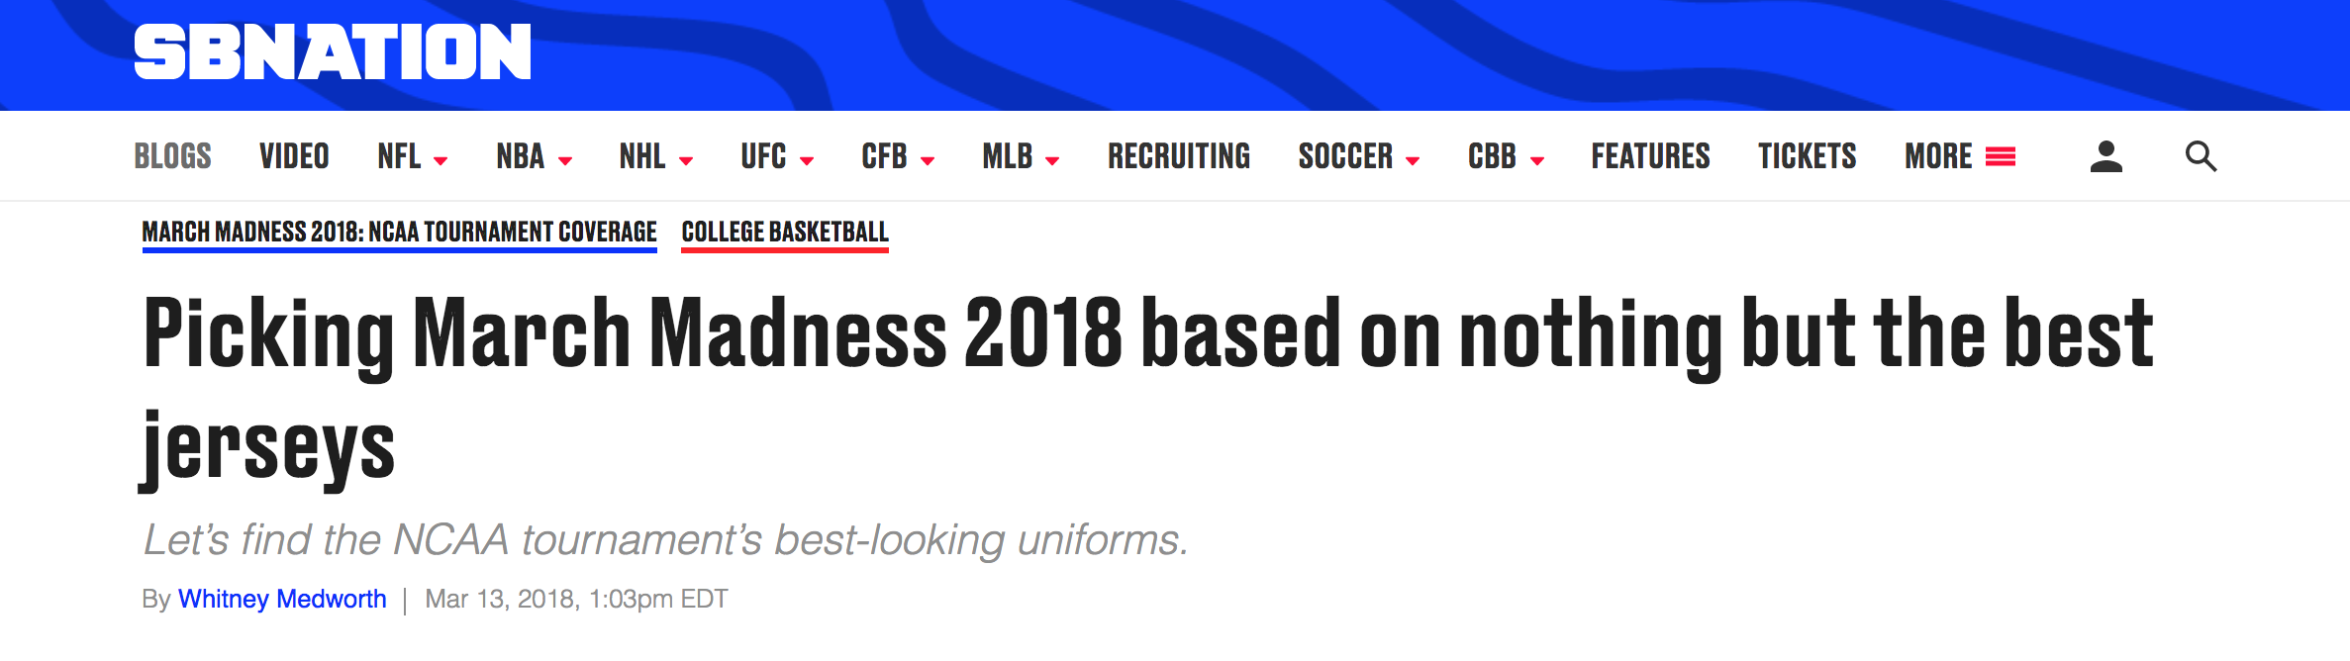
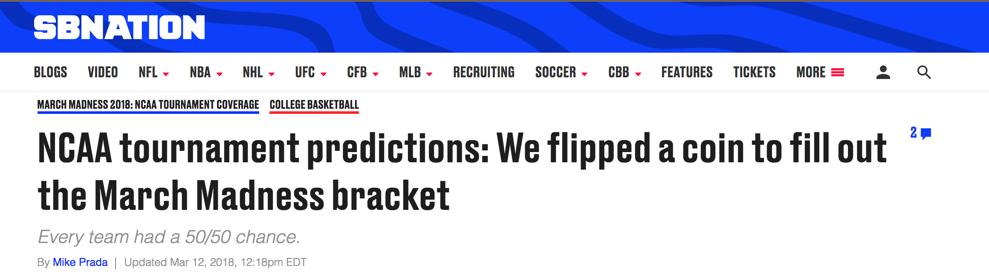
What are we trying to achieve? Why do we care?
Goal: predict game outcomes (win/loss) for 2018 “March Madness” tournament play
Use historical data and machine learning approach to make informed predictions
No one has ever made a perfect bracket*
Record for streak for correct picks in men’s is 39 games (2017)
No verified brackets that have been perfect in the Sweet 16
We will predict pairwise matchups
All possible games in 2018 tourney
*https://www.ncaa.com/news/basketball-men/bracket-beat/2017-03-14/march-madness-longest-perfect-bracket-streak-we-know
Notes:
So what?
It’s fun
People bet on it (good for Las Vegas business)
People come to be entertained - social aspect

Slide 4
Data Understanding and Preparation
Data used from Kaggle competition includes:
City locations, 1998-2017 tournament results, 1998-2018 regular season results, 1998-2018 tournament seeds
Additional data used:
Brought in our own league information from NCAA
Focus on detailed results from regular season/tourney - each unit is a matchup
Contain game-level statistics from game played; merge with team-level info (seeds, league competitiveness)
For prediction:
Most of the fields will be generated using feature engineering based on input above
Can’t use game-level stats because games haven’t been played, so use historical data and other metrics to represent relative strength of team to predict outcome

Slide 5
Feature Engineering and Selection
Win Probability
Engineered feature from regular season
Reflects a team’s annual performance relative to its league
Field goals attempted / made
Free throws attempted / made
Blocks
Rebounds
Assists
Steals
2 point goals
3 point goals
Point Opportunities Developed
Opportunity Conversion Rate
League Bin Difference
Difference in strength of leagues that each team belongs to
Reflects the competitiveness of the opponents in games that generated win prob
Seed Difference Percentage
Difference in seed between teams
Relative to the values of each seed
1 vs. 2 = (2-1) / (1+2) = 1/3
15 vs. 16 = (16-15) / (15+16) = 1/31

Slide 6
Modeling - Two-Stage
Generate ‘win probabilities’
Use regular season statistics for each team in each season to predict game outcomes
Gaussian Naive Bayes
Use the predicted probabilities as ‘win probability’ features
Predict Tournament Outcomes using Logistic Regression
Win probability
League bin difference
Seed difference percentage

Slide 7
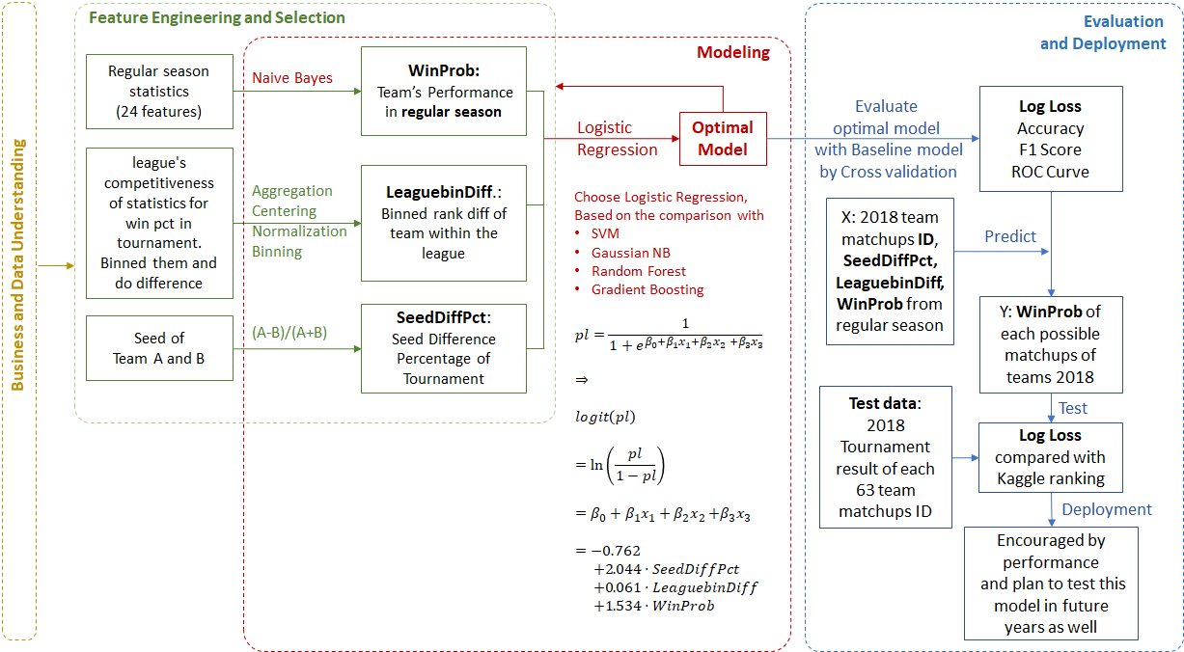
Notes:
Three features all have positive effective on the winning prob, and ranking of the effectiveness is SeedDiffPct, WinProb, and LeaguebinDiff.

Slide 8
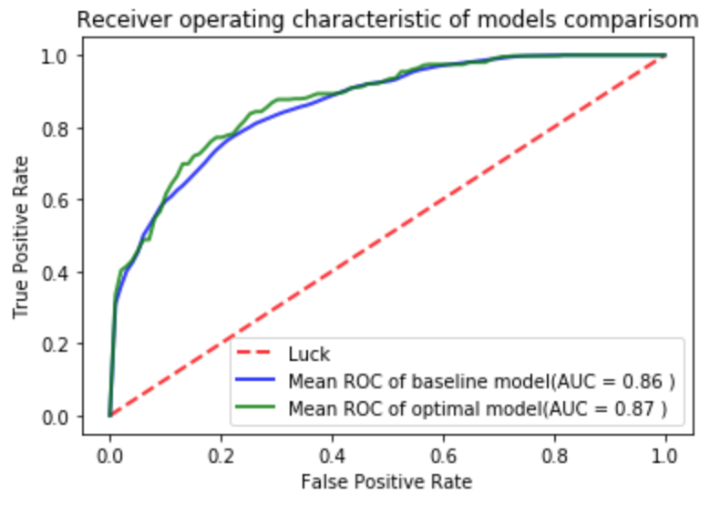
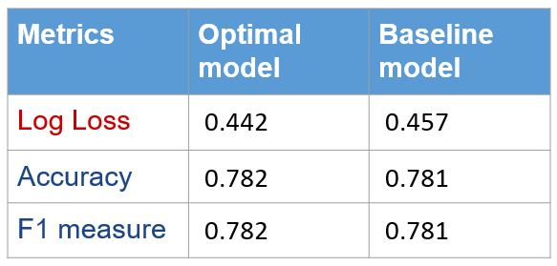
Evaluation
Evaluation with Cross validation:
Optimal model v.s. Baseline model
ROC Curve
Notes:
Evaluation:
After checking Log Loss, Accuracy, Precision and recall, F1 measure, and ROC Curve with cross validation of training data, the optimal model performs better in all measurements:
Higher accuracy and F1 score;
less false positive rate and higher AUC in ROC curve;

Slide 9
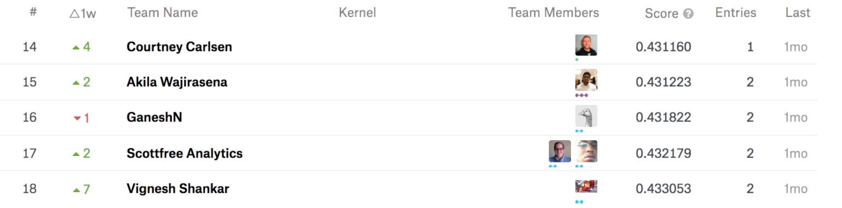
Deployment
Prediction:
Win likelihood of every potential matchup in the 2018 NCAA Division I Women’s Basketball Tournament
Competitively against other teams in the Kaggle competition with 0.43159 Log Loss score on test data ( #16)
Extension and Support:
Encouraged by our performance and plan to test this model in future years as well
https://www.kaggle.com/c/womens-machine-learning-competition-2018/leaderboard
Notes:
Deployment:
The Kaggle competition required a submission of predictions for the win likelihood of every potential matchup in the 2018 NCAA Division I Women’s Basketball Tournament. Since team1 vs. team2 is the same as team2 vs. team1, we only included the game pairs where team1 has the lower team id (total of 64*63 / 2 = 2,016 matchups). Predictions were submitted as a .csv file with a list of every possible matchup between the tournament teams and the prediction of the probability that team1 in the matchup would be team2.
However, evaluation (as described above) could only be completed for games actually played (63 matchups). The evaluation technique used in this competition is log loss. The [winning Kaggle competition submission](https://www.kaggle.com/c/womens-machine-learning-competition-2018/leaderboard) achieved a log loss of 0.406819.

Slide 10
Thank you!
Julia, Prashant, Arvindh, Charlene

